Slide 1
JOHNS HOPKINS Life Design LAB ENGINEERING Graduate STUDENTS
INTRO TO THE U.S. JOB SEARCH
for
INTERNATIONAL STUDENTS
By Mark Savage
This Presentation is Not Voiced-Over
If you never worked with a career services office at your undergraduate institution, the concept may be new to you.
At Johns Hopkins University, your Life Design Educator can be a strong ally for:
Assessing Career Interests; Resume and Cover Letter Reviews; Networking;
Interviewing; Visa-Focused Job Search Strategies

Slide 2
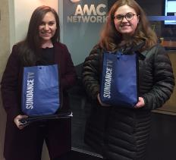
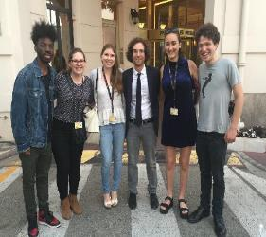
Welcome to jhu and THE Life Design LAB
Our Mission:
Provide all students and alumni the experiences, knowledge, skills and tools to make smart career decisions and to package and prepare themselves for their pursuits.
Close the gap between what employers seek in graduates and what students / alumni are equipped with.
Orchestrate university-wide connections to build the “best possible” career ready network.
Build enduring career readiness capabilities – those that last beyond first destinations.
Be a catalyst for alumni engagement – lifetime affiliation.
Notes:
This is the why of the Career Center: We will help you integrate your career development into all aspects of your college experience. While at JHU, you will develop skills that for lifelong career success.
Left picture: PR Trek to New York, January 2017, AMC network
Right picture: Students at Canne Film Festival, May 2017, with actor Kyle Mooney

Slide 3
Terms Used in This Presentation (1 of 2)
Behavioral Interview: A job interview comprised of questions based on a person’s past performance in handling a specific situation or scenario, typically asked in the form of: Tell me about a time when you…
The answer must depict an event that the interviewee handled at a specific point in time. (See STAR METHOD)
Bi-Cultural: The ability to view, understand and accept events, practices and protocols through the perspectives of one’s original culture and a second culture in which one has been immersed.
Culture: How one thinks, acts, believes, and interacts, based on the society in which one was raised.
Fit: The ability for an individual to effectively connect and work with a team through knowledge, experience, likability and sharing of common work-related values, traits, behaviors and attitudes.
Green Card: See Permanent Resident: Green Card Holders may plan to eventually attain US citizenship.
H1-B Visa: An employer-sponsored elective work visa for an international college graduate after OPT has ended, with a maximum term of 6 years.
Interviewee: A person who is interviewed and evaluated for their ability and interest to perform an available work position within an organization.
Interviewer: A person or group, often in authority, who conducts a job interview to determine someone’s qualifications and suitability for a specific job opening within an organization.
Likability: The extent by which people may take interest in and enjoy the company of another person.
LinkedIn: An online social media site that facilitates individuals to connect, maintain contact, and share photographs or articles of interest with people they know or have something in common.

Slide 4
Terms Used in This Presentation (2 of 2)
Lottery: A US Government random process that allocates employer-sponsored requests for H1-B Sponsorship among OPT holders. 85,000 H1-B visas are awarded annually, with 65,000 granted to undergraduate and graduate degree holders and an additional 20,000 awarded only to Masters and PhD graduates. Because STEM graduates can extend OPT status for up to 3 years, they may have up to 3 chances to be selected for H1-B status (once each year) while working on OPT status.
OPT The first temporary US work visa status, applied for by international students through the Office for (Optional Practical Training): International Services in the last months before graduation. Generally valid for 1year, it can be valid for up to 3 years for graduates of STEM majors. The work must relate to the graduate’s field of study.
Permanent Resident / Work Visa Status secured by an employer sponsor prior to expiration of the H1-B Visa; Permanent
Green Card: Residents are issued a “Green Card.” Most eventually seek to become US Citizens. It can be expensive for an employer, who may need to document an inability to find a US citizen for the work.
Plan A, Plan B, Plan C, etc.: Alternative plans, in this case, applied to employment possibilities to increase chances to remain in or to eventually return to the United States for work.
Networking: The practice of connecting with other people with whom one has something in common or a shared interest, often accomplished through third-party referrals, direct outreach, or social media sites such as LinkedIn, PeopleGrove, Facebook, etc.
Passion: Extreme pleasure or liking for an activity, an item, a place, a belief, or a practice.
STAR Method: A method for answering Behavioral Interview questions (see above) based on a specific experience or scenario in which the interviewee describes the SITUATION s/he faced, the TASK s/he needed to perform to resolve the situation, the ACTION s/he took to resolve the situation, and the end RESULT.
STEM: Science, Technology, Engineering, Mathematics as applied to a field of study or work setting.

Slide 5
Test Your Knowledge
TRUE or FALSE ?
Career Success Strategies for International Students
Doing an internship is more helpful in securing a job in the US after gradation than getting a very high GPA.
TRUE -- A US based internship shows experience in the US work culture and is easier for employers to track reference checks.
Employers always have full knowledge of CPT / OPT laws, so you don’t need to inform them about it.
FALSE -- Employers may not always know the facts and may assume hiring a foreign national is more difficult or more expensive than it really is – especially for CPT-based internships.
When looking for a job, you should always search in big cities and major metropolitan areas rather than in smaller cities or less popular regions of the US because more jobs are likely to be available there.
FALSE -- Jobs in smaller cities or less popular areas of the US can offer great experience and often have less competition.
It will be difficult to establish a network of contacts in the US because I don’t have family connections here.
FALSE -- Start with faculty, alumni, and contacts of US friends through LinkedIn and other social media sites, as well as directly with employers through career fairs and campus recruiting events.
If you worked in your family business back in your home country, you should include it on your resume.
TRUE -- Skills are the same all over the world, and you may have gained more experience in your family’s business than in an internship in your country, where you may have been allowed to only do menial jobs.

Slide 6
JOHNS HOPKINS Life design LAB ENGINEERING GRADUATE STUDENTS
You may feel uncertain or overwhelmed when starting your US-based job search. The process ramps up quickly in September, so you must prepare early.
Your Life Design Educator is aware of these challenges and will help prepare you.
Try to overcome any cultural barriers from home that may impede pursuing your career goals and job search in the US.
Who are you?
Why did you come to study in the US?
How has your culture influenced you?
What strengths & weaknesses do you bring to your graduate study?
You’ll want to learn to tell your story and start interacting with people.

Slide 7
.
SOME VIEWS ON EMPLOYING INTERNATIONAL STUDENTS
Bureaucratic legal costs, deadlines, and risks associated with sponsorship can lead some employers to be reluctant to hire students needing H-1B visa sponsorship… and there is no guarantee that the process will be successful for every international student. Demand for H-1B visas has exceeded the available annual number of visas, leading some companies to view the process as a hassle.
Well-known companies that attract many applicants may base hiring upon availability of qualified citizens to fill job openings.
Others may understand the process, but think they don’t need to hire international students -- so they choose not to interview them.
Some are confused about the process: What they can and cannot do.
Employers care first about their own needs and goals –
……… AND THEN THEY MAY CONSIDER YOURS!

Slide 8
SOME VIEWS ON EMPLOYING INTERNATIONAL STUDENTS
However, many US employers acknowledge that recent hires who had international experience outperformed others in:
Expressing different interests, values, or perspectives
Understanding cultural differences in the workplace
Adapting to change
Applying new knowledge gained from experience
Handling unfamiliar tasks, applying knowledge in new or broader contexts, and identifying problems & solutions
Working effectively with coworkers
How might your previous academic & work experiences address these areas?

Slide 9
Networking: Because jobs in the US are often filled through referrals, you’ll want to build connections and alliances with faculty, staff, alumni, and others.
Central to your job search, networking may be unfamiliar to you (maybe even considered pushy, boastful, or rude in your culture), so it may be a difficult concept to master at first.
However, networking provides an opportunity for people to share their knowledge and experience, and that can make them feel good.
People who share things in common with you may want to help: Therefore, you should approach others with a desire to learn from them, and not so much to seek job leads or to access their contact network.
THE US JOB SEARCH IS A TEAM EXERCISE

Slide 10
Join clubs & interest groups, volunteer, and connect with people of various ages and social / economic backgrounds on campus and in the Baltimore community.
Be genuine, listen, respect people’s time, and don’t worry about your accent. People want to engage in real conversation; If they like you, they may offer to help you! Also network with other international students.
Use social networking such as LinkedIn to find alumni and others who can offer advice or who may work for employers or in geographic areas or of potential interest.
In a job interview, do discuss your current US education and experience, but also talk about your home country experience. Focus on your accomplishments, what you learned, and how you succeeded.
If you have no work experience, talk about a school or volunteer project. Relate your skills, past experience and motivation for success to the job you’re discussing while convincingly expressing strong interest.
Impactful storytelling will help your interviewer know what you’re all about.

Slide 11
Your resume, the reputation of Johns Hopkins, and your skills will help you secure interviews, but once you’ve proven your capability to do the job, your “likability” will help you get the job.
Smile, compliment people, and thank your interviewers. DON’T focus too much on self-promotion, but DO share your story – and not only your professional goals – to establish rapport with people who want to learn about your unique and interesting story.
THE LIKABILITY FACTOR

Slide 12
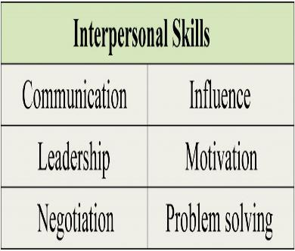
HOW MIGHT YOU “FIT” IN WITH THE WORKTEAM?
The concept of “fit” can be confusing. Craft stories that incorporate how your strong background can be of value to the employer.
Great grades can reflect knowledge, but employers also value “soft skills:” - the ability to work with people; resolve conflicts; communicate and present; gain customer trust; disagree respectfully; etc. International students can sometimes be perceived as lacking in these skills.
Socialize with Americans: Understand how they behave and think. Show a desire to enhance performance of the team you want to join.
Hiring managers want evidence of both your ability and your passion:
They want to see that you love what you do. Ask insightful questions that show you understand what they’re looking for. Weaker candidates who express passion sometimes win over stronger, more experienced candidates. If people don’t like you, you won’t “fit.”

Slide 13
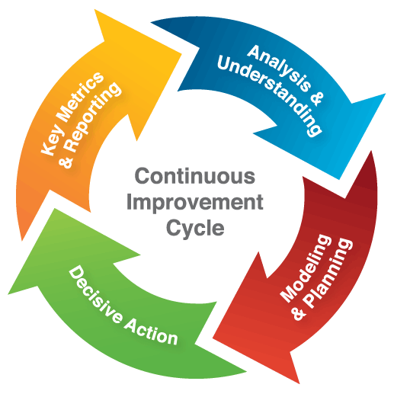
Job descriptions don’t always give a true sense of the job.
Determine issues the manager cares about and present yourself as a candidate who will give more than what is expected. Americans value collaboration and teamwork.
When you see an opportunity to make something better or more efficient, take action. Many international students worked with limited resources before arriving in the US. Their drive and initiative led them to achieve strong results.

Slide 14
US employers expect you to relate confidently about yourself and your successes: Self-promotion may be uncommon, or even rude in your country’s culture; however, you should take credit for and be proud (but not boastful) of your accomplishments.
Some international students can appear too modest in US job interviews. Look directly at the interviewer, smile, and answer questions with confidence as best as you can.
If you do not understand a question, do not hesitate to ask for clarification.
You will also want to prepare a list of questions to ask about the job, training, company culture, etc. Although an interview is kind of a “test” -- realize it is, first and foremost, a conversation.
Afterwards, both the interviewer and interviewee should feel as if they both had a great conversation.
THE INTERVIEW

Slide 15
Continue to Practice Story Telling, especially in preparation for Behaviorial Interview questions.
US Job interviews are as much about potential fit as they are about grades and academic success.
Behavioral Interviews are based on past performance as the best prediction of future performance. The focus is on situations from your past that may have been awkward or challenging to resolve. Your Career Mentor can train you in the STAR Approach to handle such questions.
Behavioral Interview Questions often begin with: “Tell me about a time when you…”
In a Behavioral interview, you must tell a story, start to finish, that relates to the question. Using the S-T-A-R Approach, your story should:
Define the SITUATION (and/or TASK) you faced
Describe the ACTIONS you took to resolve it
Conclude with the RESULTS
YOU MUST describe a relevant incident that happened at a specific time in your past; DO NOT describe how you might handle such a situation in the future.
The Interview
.

Slide 16
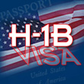
H1-B VISA
Engage your multi-cultural perspectives to describe what is unique about you. Emphasize your global mobility, language skills, knowledge of your home region, and technical or quantitative expertise.
Focus on both your experience and studies to display unique and interesting career insights and interests.
International students should know about the basic H-1B visa process (quotas, eligibility, rules, etc.), but they need not be experts.
Most companies willing to sponsor will consult an immigration attorney to file an application, typically a simple inexpensive process ($5,000 - $6,000).
Employers who wish to sponsor someone for an H-1B visa DO NOT need to prove they were unable to find a qualified US citizen for the job.

Slide 17
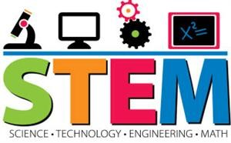
Because fewer US students pursue advanced STEM degrees, (Science, Technology, Engineering & Mathematics) master’s students in STEM fields qualify for 36 mo. of OPT vs.12 mo. for non-STEM majors. The 24-month extension allows your employer to petition for your H-1B visa up to 3 TIMES.
Further information on the OPT extension and the H-1B, and can be found at
https://www.uscis.gov/working-united-states/students-and-exchange-visitors/students-and-employment/stem-opt
Addressing a statewide brain drain, the State of Michigan encourages Detroit area companies to recruit international students through the GTRI Program: http://www.migtri.org/student-resources/
and http://www.migtri.org/wordpress/wp-content/uploads/2014/11/Reworked-partners-page.pdf

Slide 18
H-1B VISA DETAILS AT www.uscis.gov
The H-1B visa is not the only work visa, but for international students, it is the most common.
Most recently, 85,000 annual H-1B visas were available (65,000 for ALL applicants --- and 20,000 more only for students completing a Master’s or PhD degree, all selected through an annual lottery process).
International students who don’t obtain an H-1B through the lottery typically leave the US, re-enroll as an F-1 student in a new degree program, or marry a citizen to stay in the US.

Slide 19
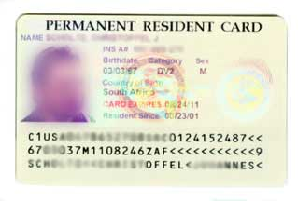
With 1 – 3 years on Optional Practical Training (OPT) and a maximum of 6 years on an H-1B visa, an employer could employ a foreign national for 7 – 9 years without filing for Permanent Residency (Green Card).
Filing for permanent residency is a more complex and expensive process, and employers may need to prove they could not find a qualified US Citizen for the job.
H-1B VISA DETAILS AT www.uscis.gov
Always consult with the JHU Office of International Services for Details

Slide 20
H-1B VISA DETAILS AT www.uscis.gov
Based on a recent H-1B filing season, an international student with a Bachelor’s degree had ~ 35% chance to be selected for one of 65,000 available H-1B visas from the 190,098 applications filed.
Your odds of securing an H-1B are closer to 50% if you also qualify to compete for the pool of 20,000 extra H-1B visas available only to candidates holding a US Master’s degree or higher.
Students completing an engineering or science degree should be able to apply for the H-1B up to three times while working on Optional Practical Training (OPT).
Always consult with the JHU Office of International Services for Details

Slide 21
TO THINK ABOUT….
International job seekers who wish to remain in the US after graduation should have a Plan A, a Plan B, and maybe a Plan C. If your job search is moving slowly, don’t wait too long to change direction and expand your job search targets to incorporate new industries, new job functions or new geographical areas.
You might consider approaching US companies that have operations in your country to hire you on OPT in the US, and before it expires, relocate you to your home country.
You might consider an international rotation program with a US company in another country (perhaps your own?), and then try later to transfer back to the US on an L-1 visa, which may allow US companies operating abroad to transfer employees to the US.
If you don’t have a job at graduation, but want to stay in the US, you may be able to use your OPT on a temporary job and continue to search.
Always Consult with the JHU Office of International Services
before you accept ANY paid or unpaid employment in the US.

Slide 22
TEST YOUR KNOWLEDGE
Answer TRUE or FALSE for each question below.
1. Demand for H-1B visas has exceeded the available annual number of visas in recent years.
TRUE -- Typically, about 198,000 applications are filed for 65,000 – 85,00 H-1B Visas
Applying to jobs posted online is the best way to conduct a job search
FALSE -- You should bolster your job search through networking with people who have things in common with you
You should not talk about experience from your home country in a job interview.
FALSE -- Your experience from your home country provides you with insights and perspectives that US citizens may not offer
Your resume, your likability, and the reputation of Johns Hopkins University will help you to secure interviews
TRUE -- These are positive factors that will help you get noticed, but there is no guarantee.
US employers consider “fit” to be a primary factor when interviewing job candidates
TRUE -- Employers consider “Fit” for the job requirements, for the organization, and for the team to be very important
Behavioral Interviews are based upon future potential and can be addressed using the STAB approach.
FALSE -- Behavioral Interviews are based upon past performance and can be addressed using the STAR approach
After a job interview, the interviewer and the interviewee should both feel as if they had a great conversation
TRUE -- Both parties should feel as if they just had a great conversation after an interview
Employers who wish to sponsor someone for an H-1B visa must prove they were unable to find a qualified US citizen for the job.
FALSE -- Employers need not prove they were unable to find a qualified US Citizen for the job
The 24-month OPT extension for STEM graduates allows an employer to petition for your H-1B visa up to 3 times
TRUE -- STEM graduates can work on OPT for up to 3 years and employers can petition for their H-1B visa up to 3 times
After the first 65,000 H-1B visas are awarded in the annual lottery process, 20,000 more visas are available only to graduate students
TRUE -- After the initial 65,000 H1-B visas are awarded in the annual lottery, graduate students can qualify for 20,000 more visas
11. International students should always consult with a Life Design Educator before accepting any paid or unpaid employment in the US.
FALSE -- International students should always consult with the Office of International Services for any employment issues

Slide 23
A Few Resources
Internet
https://optnation.com Provides employer listings that provide OPT
www.internationalstudent careers.com/international-student-jobs/
http://www.myvisajobs.com/ Lists US employers that were granted H-1B visas in the current year
Goinglobal (accessed via JHU Handshake) H-1B Tab: Lists employers granted H-1B visas in the current year -- NOTE: Jobs Tab leads to job board, but not restricted to those providing OPT or H-1B status
www.jiesworld.com American and international corporations in China
JobKoreaUSA US Jobs with focus on Korean students
Business Maps of India US Companies Operating in India
https://www.careercross.com/en Jobs in Japan
Career Fairs
https://careerforum.net/en/event/bos/ World’s largest job fair for Japanese-English Bilinguals
https://ecf.fairsey.com/#!/ MIT European Career Fair – Companies hiring for jobs in Europe
MIT Asian Career Fair Companies hiring for jobs in Asia
Book Quotes
http:powerties.com Author Dan Beaudry’s speaking engagements on international student job search
http://www.powerties.net/frequently-asked-questions-and-answers/ More from Dan Beaudry
http://theinternationaladvantage.com/ From Marcello Barros’ book, The International Advantage

Slide 24
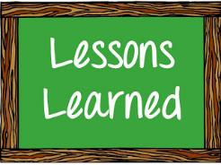
THINK ABOUT
Name one of your biggest accomplishments
or something you are proud of in your life?
What are three things you learned from this workshop today?

Slide 25
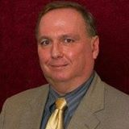
GET STARTED ON YOUR CAREER JOURNEY
WE’RE HERE TO HELP FOR ANY CAREER OR JOB SEARCH ISSUE!
BEFORE STARTING YOUR PROGRAM:
Set up an account on Handshake
(JHU’s Recruitment Management System)
https://jhu.joinhandshake.com
(use your JHED-ID & Password)
2. Set up an account on LinkedIn if needed
3. Draft a US-formatted Resume (Online Course)
AFTER STARTING YOUR PROGRAM:
1. Have your resume critiqued
2. Draft a Cover Letter and Have it Critiqued
3. Perfect your Resume and Cover Letter
4. Prepare for Campus Career Fairs & Apply for Job
5. Touch Base With Your Career Mentor as Needed
Mark Savage,
Life Design Educator
Engineering Masters Students (Homewood & EP)
Except Those Noted Below
msavag16@jhu.edu
Sonjala Williams,
Life Design Educator
Homewood Engineering Masters Students in
Applied Math, Data Science, Financial Math, Statistics
Sonjala@jhu.edu
Roshni Rao
Director of Phutures
PhD & Post-Docs
rrao12@jhu.edu

