Slide 1
Finding Clinical Experiences During COVID-19
Johns Hopkins University
Office of Pre-Professional Programs and Advising
https://studentaffairs.jhu.edu/preprofadvising/
3/2021
Notes:
Pre-Professional Advising understands that many students are finding it difficult to engage in clinical experiences due to Covid-19 related restrictions. As such, we’d like to offer a few ideas:

Slide 2
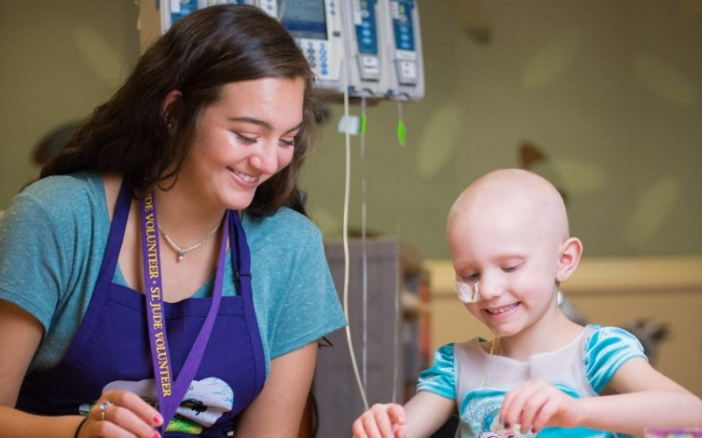
In-Person Clinical Volunteering
Contact volunteer offices of local hospitals, hospice centers, and community clinics
Opportunities vary across the country, and even within states
Volunteering policies and procedures are changing as infection rates change
An organization that does not accept in-person volunteers today may accept volunteers in a few months
Notes:
If you’re seeking in-person clinical volunteering, contact the volunteer offices of local hospitals, hospice centers, and community clinics. Some in-person clinical opportunities do exist, as Covid restrictions vary across the country, even within states. Volunteering policies and procedures are changing as infection rates change and safety measures are adapted, so an organization that does not accept volunteers today might be accepting volunteers in a few months.

Slide 3
Virtual Clinical Volunteering
Contact volunteer offices of local hospitals, hospice centers, and community clinics
Search online for local, national, and/or global health care organizations
Some organizations have adapted to virtual scenarios
Communicate with patients via phone, computer, or tablets
Allows for volunteering essentially anywhere in the world at any time of the day
Notes:
If you’re seeking virtual clinical volunteering, contact the volunteer offices of local hospitals, hospice centers, and community clinics. Some organizations that are unable to continue in-person volunteering have adapted to virtual scenarios. In these situations, you can communicate with patients via phone, computer, or tablet. Virtual volunteering also enables you to volunteer anywhere in the country or the world, at almost any time of day. An online search of health care organizations near—and far—will be a good place to start your inquiry.

Slide 4
Clinical Research
Clinical research should not exclusively focus on data analysis; it’s important to be communicating and working with patients
If interested in clinical research affiliated with Johns Hopkins:
Search ForagerOne through the Hopkins Office of Undergraduate research (HOUR)
Directly reach out to faculty at the School of Medicine, School of Nursing, Bloomberg School of Public Health or Johns Hopkins Bayview
Notes:
Clinical research is another option for obtaining patient interaction. But if you choose to engage in clinical research, please ensure you are able to communicate and work with patients. In other words, we’d like to see clinical research that includes more than data analysis. If you’re looking for clinical research affiliated with Johns Hopkins, we invite you to search the ForagerOne platform through the Hopkins Office of Undergraduate Research (HOUR), or to directly reach out to faculty at the SoM, SoN, Bloomberg SPH, or Bayview.

Slide 5
Online Learning/virtual shadowing
Not “shadowing” as we traditionally think of it:
Physicians and other healthcare providers teaching about their profession, sharing case studies, etc.
Watch YouTube videos, take free online courses, and attend virtual seminars
Demonstrates that you are continuing to learn about healthcare, patient care, and medicine
Resources available through an online search of virtual shadowing or through the Pre-Professional Advising Home Page
Notes:
If you cannot find any clinical volunteering or clinical research, whether in-person or virtually, we suggest online learning. YouTube videos and online courses abound, and participating in these virtual opportunities demonstrates that you are continuing to learn about healthcare, patient care, and medicine. You can find resources through an online search of virtual shadowing, or through the Pre-Professional Advising Home Page.

Slide 6
Other ways to gain clinical experiences
EMT, Medical Assistant, or Certified Nursing Assistant
It’s great to get certifications, but then need to use the skills
Can be costly and time consuming to get certifications
Given the demands of these jobs, they can be difficult to do if you are a full-time student
Scribing
Given the demands of the job, this can be difficult to do if you are a full-time student.
Notes:
In closing, although the pandemic changed many plans, it’s important to continue finding meaningful experiences, be creative, and demonstrate your adaptability and resilience. This applies not only to clinical experiences, but also to research, community service, extra-curricular activities, and academics. If you wish to discuss resources or ideas in greater detail, we invite you to make an appointment with a Pre-Professional advisor.

Slide 7
Conclusion
Continue finding meaningful experiences and demonstrate your adaptability and resilience during these times
Be creative, think “outside the box,” try something new
This advice is not limited to clinical experiences-- this also applies to research, community service, and extra-curricular activities
Please make an appointment with a Pre-Professional advisor if you have further questions
Notes:
In closing, although the pandemic changed many plans, it’s important to continue finding meaningful experiences, be creative, and demonstrate your adaptability and resilience. This applies not only to clinical experiences, but also to research, community service, extra-curricular activities, and academics. If you wish to discuss resources or ideas in greater detail, we invite you to make an appointment with a Pre-Professional advisor.

Slide 8
Resources
Ideas for virtual or in-person volunteering in Baltimore
Johns Hopkins Hospital
Johns Hopkins Bayview
Mercy Medical Center
University of Maryland Medical Center (Shock Trauma)
Mt. Washington Pediatric Hospital
Shepherd’s Clinic
Gilchrist Hospice
Clinical organizations supported by JHU’s Office of Social Concern
We encourage you to contact the volunteer offices of hospitals and community clinics near you
Notes:
In Baltimore, some ideas for virtual or in-person volunteering might include Johns Hopkins Hospital, Mercy Medical Center, University of Maryland Medical Center, Mt. Washington Pediatric Hospital, Shepherd’s Clinic, Hopkins Community Connection, and Gilchrist Hospice. We encourage you to contact the volunteer offices of hospitals and community clinics near you.

